Slide 1
Chem 108: Lab
Week 15
Sign in
Pick up Papers
Choose a partner for today’s experiment

Slide 2
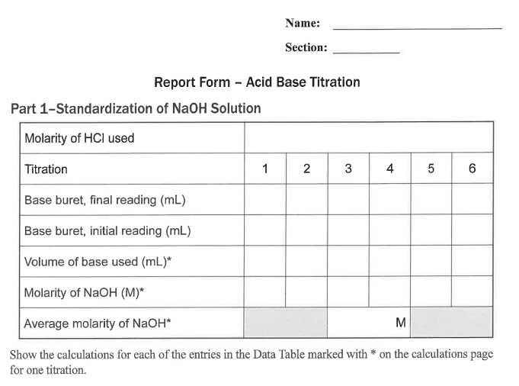
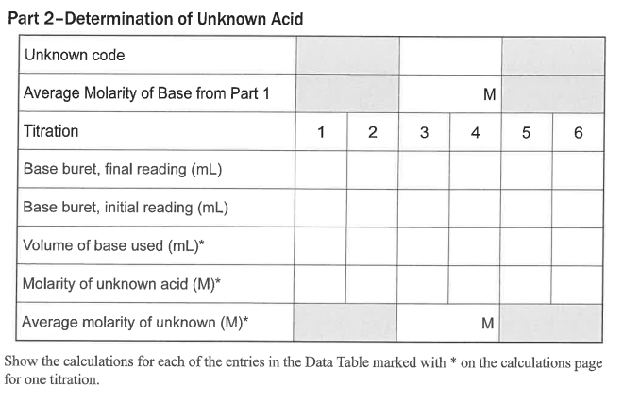
Chem 108: Lab
Due Today:
Acid-Base Titration
Complete Individual Report form pp.94-96.
Include
clear
calculations
with units.
0.2099 mol/L
Notes:
A 3900-year-old clay tablet, which was found in Iraq between the Tigris and Euphrates rivers, had a Sumerian poem (http://www.piney.com/BabNinkasi.html) honoring Ninkasi, the patron goddess of brewing. It contains the oldest surviving beer recipe, describing the fermentation of the carbohydrates found in bread, bappir, made from barley, honey, dates and sweet aromatic herbs. The global availability of carbohydrates and native microbes (yeasts) has led to the production of many different types of beers, ales, wines, and fruit based alcoholic beverages in many countries throughout the world. [The bottle on the left was found in Eugene, Oregon, ……. But, it dates only to 2016.]

Slide 3
Unkown Acid Neutralization
Net Ionic Equation/ Calculation
H⁺_{(aq)} + OH ⁻_{(aq)} H₂O_{(l)}
acid
base
water
  25.00 mL of M_{H+ aq}= ? (unknown acid solution) was titrated with a sodium hydroxide solution, M_{OH-}= ? 0.2162 M. It required 24.20 mL as an average of three trials which were within +/- 0.20 mL to reach a faint pink color.
?M_{H+} = [M_{OH-} x V_{OH-} / V_{H+} ] [? mol_{H+} / ? mol_{OH-}]
0.2162 mol_{OH-} x 0.02420 L_{OH-} x 1 mol_{H+}
L_{OH-} x 0.02500 L_{H+} x 1 mol_{OH-}
=
= 0.2093 M_{H+}

Slide 4
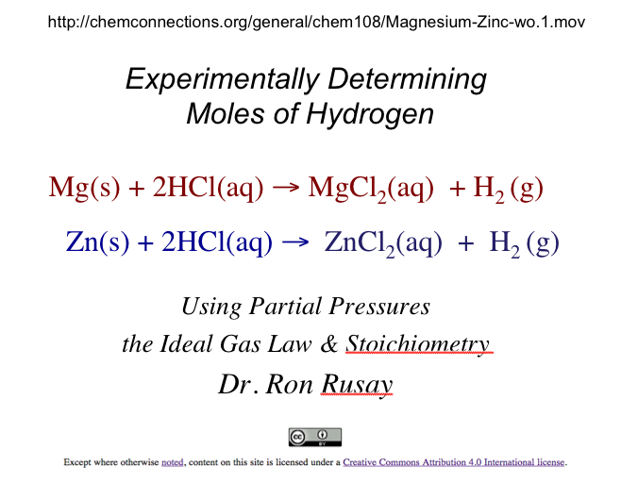
Today’s Experiment
Gas Stoichiometry

Slide 5
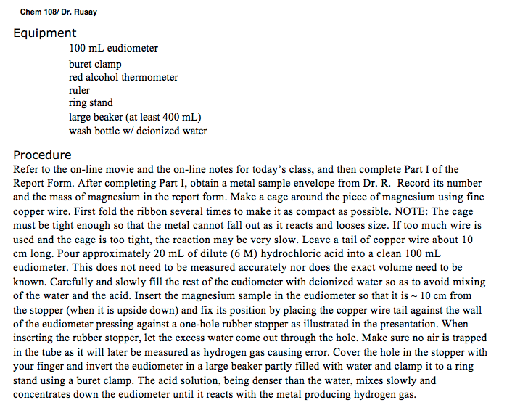
Refer to the Procedure section pp. 54-56. The following slides correspond to the instructions in the procedure.

Slide 6
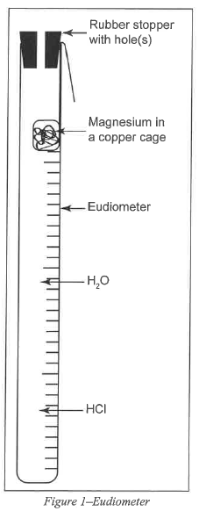
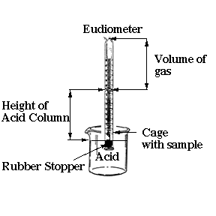

Slide 7
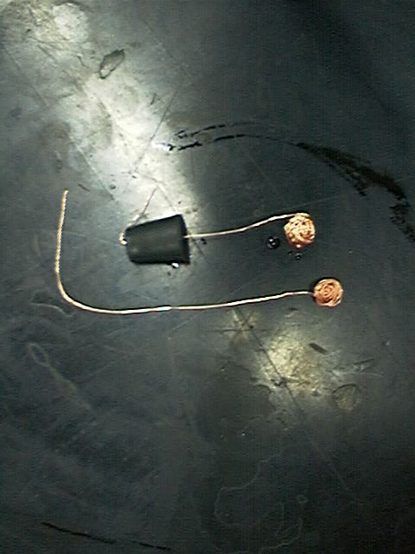
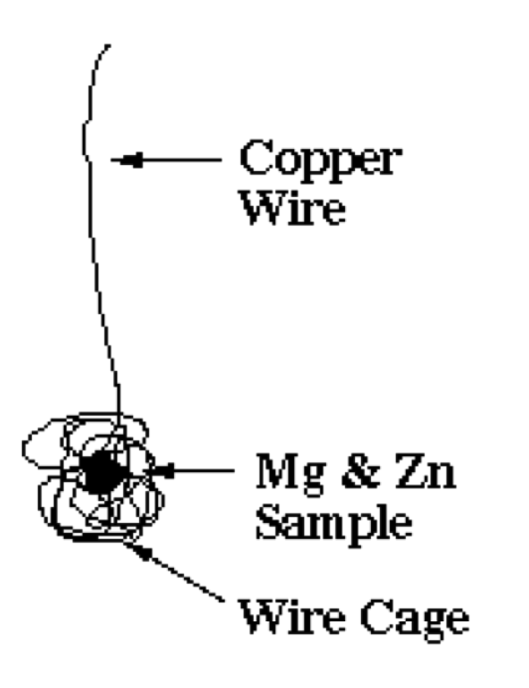
What is wrong with this set up?
Mg or Zn
Mg or Zn

Slide 8
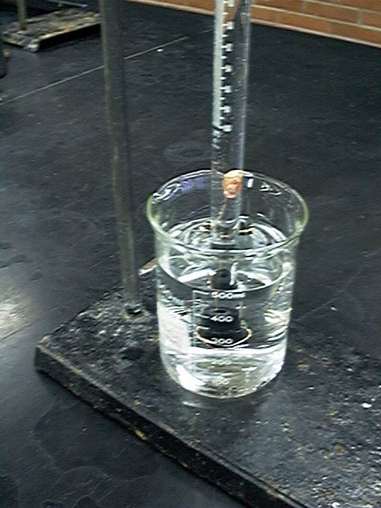
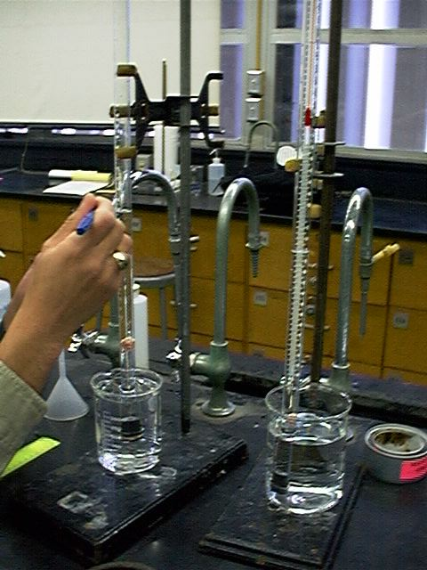
Mg(s) + 2HCl(aq) → MgCl₂(aq) + H₂ (g)
Zn(s) + 2HCl(aq) → ZnCl₂(aq) + H₂ (g)

Slide 9
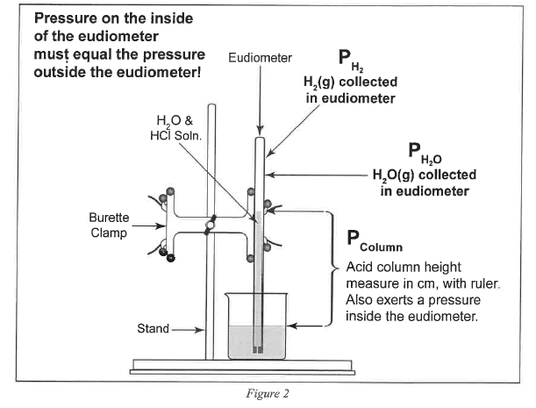
Mg or Zn

Slide 10
Refer to the Gas Stoichiometry Report Form, pg. 58-59
Experimental data is to be obtained for the reaction of a known mass of magnesium metal:
The volume of hydrogen, pressure and temperature determined and recorded.
Moles of hydrogen is calculated using Ideal Gas Law calculations, then calculating mass of the starting magnesium from the number of moles of hydrogen.
Mg(s) + 2HCl(aq) → MgCl₂(aq) + H₂ (g)

Slide 11
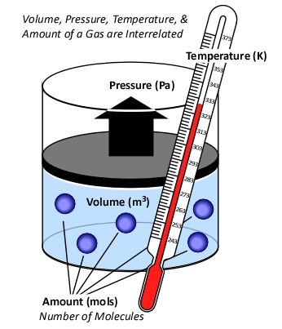
Background
Ideal Gas Law
PV = n RT
R = “proportionality” constant
  = 0.08206 L atm Κ⁻¹ mol⁻¹
P = pressure of gas in atm
V = volume of gas in liters
n = moles of gas
T = temperature of gas in Kelvin

Slide 12
Standard Conditions
Temperature, Pressure & Moles
“STP”
For 1 mole of a gas at STP:
P = 1 atmosphere
T = 0°C (273.15 K)
The molar volume of an ideal gas is 22.42 liters at STP

Slide 13
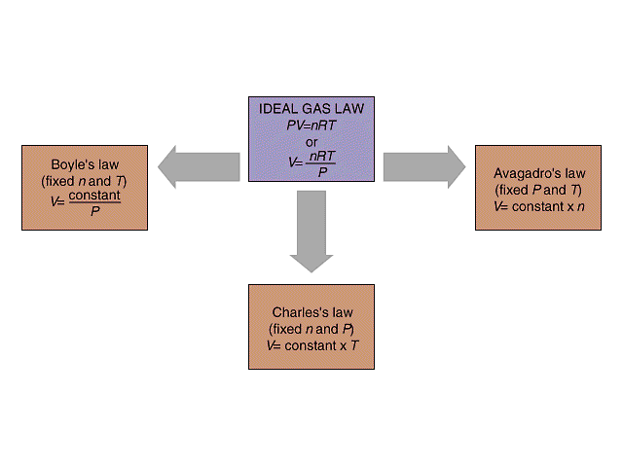
Isobaric process: pressure constant
Isochoric process: volume constant
Isothermal process: temperature constant
P₁ V₁ = P₂ V₂
P V
V₁ / n₁ = V₂ / n₂
V n
Standard Conditions (STP)
273 K, 1.0 atm,
R = 0.08206 L atm/ K mol
@STP
1 mole of any “ideal” gas has
a volume of 22.4 Liters.
Combined Gas Law
P₁V₁ / T₁ = P₂V₂ / T₂
V₁ / T₁ = V₂ / T₂
V T

Slide 14
Hydrogen & the Ideal Gas Law
n H₂(g) = PV / RT
n = moles H₂(g)
P H₂(g) = pressure of H₂(g) in atm (mm Hg → atm)
V = experimental volume (mL→ L)
T = experimental temperature (ºC → K)
Mg(s) + 2HCl(aq) → MgCl₂(aq) + H₂ (g)
Zn(s) + 2HCl(aq) → ZnCl₂(aq) + H₂ (g)

Slide 15
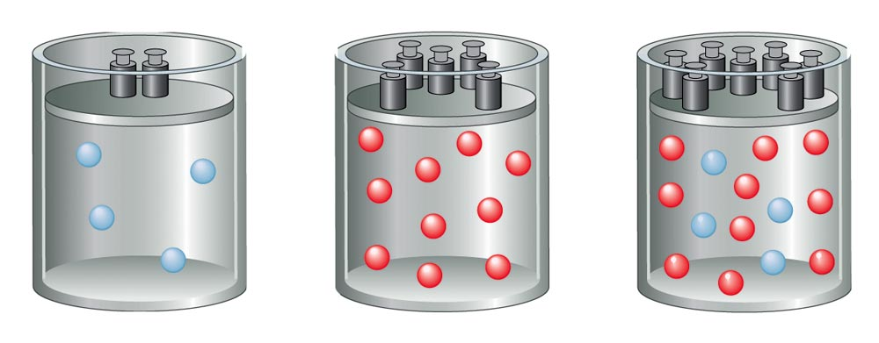
Total Pressure:
Sum of the Partial Pressures
For a mixture of gases, the total pressure is the sum of the pressures of each gas in the mixture.
  P_{Total} = P₁ + P₂ + P₃ + . . .
P_{Total} ∝ n _{Total}
n_{Total} = n₁ + n₂ + n₃ + . . .

Slide 16
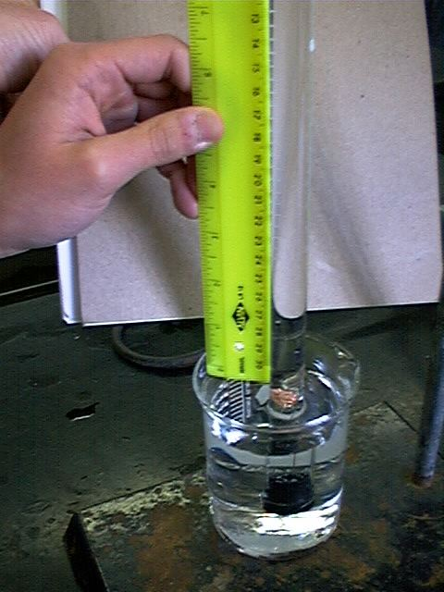
P H₂(g) = P Total (barometric) - P H₂O (g) [TABLE] - P HCl (g)
P HCl (g) =
HCl Height (mm) ÷ 12.95
___________
Density Hg is 12.95 times > density HCl(aq)
P HCl (g) =
HCl Height (mm) x 0.0772
___________
Density Hg is 12.95 times > density HCl(aq)
0.772 mm Hg/cm of acid solution

Slide 17
Ideal Gas Law:
Moles / Avogadro’s Law
n H₂(g) = PV / RT
n = moles H₂(g)
P H₂(g) = pressure of H₂(g) in atm (mm Hg → atm)
P H₂(g) = P Total (barometric) - P H₂O (g) [TABLE] - P HCl (g)
V = experimental volume (mL→ L)
T = experimental temperature (ºC → K)
R = 0.082057338 L atm K⁻¹ mol⁻¹ (constant)
Mg(s) + 2HCl(aq) → MgCl₂(aq) + H₂ (g)
Zn(s) + 2HCl(aq) → ZnCl₂(aq) + H₂ (g)

Slide 18
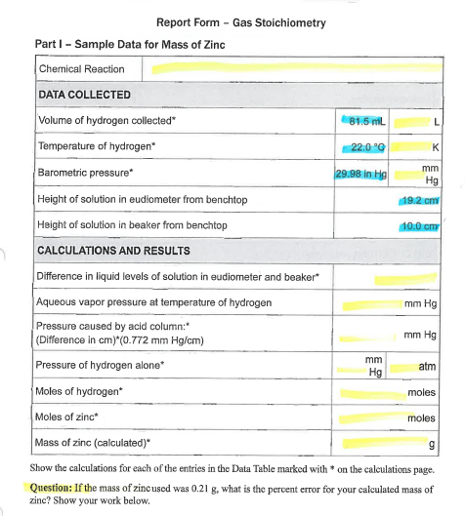
Refer to Report Form Part I: (Example uses Zinc.)
Mole Calculations:
Stoichiometry Calculation
Ideal Gas Law Calculations
Comparison (% Error)
Zn(s) + 2HCl(aq) → ZnCl₂(aq) + H₂ (g)
Complete Report Form with Calculations; Needed to get unknown Mg(s) sample(s).

Slide 19
Stoichiometry
Moles Hydrogen / Mass of Zinc
(Part I: Zinc Calculation)
Zn(s) + 2HCl(aq) → ZnCl₂(aq) + H₂ (g)
mol H₂(g) = mol Zn(s)
mass (g) Zn(s) = mol Zn(s) x Molar Mass Zn(s)
Zn(s) + 2H⁺(aq) → Zn²⁺(aq) + H₂ (g)

Slide 20
Zinc Example Calculation
Complete Report Form pg. 58 Part I:
Mole Calculations:
Stoichiometry Calculation
Ideal Gas Law Calculations
Comparison (% Error)
Zn(s) + 2HCl(aq) → ZnCl₂(aq) + H₂ (g)

Slide 21
Moles : Ideal Gas Law
(Part I: Zinc Calculation Example)
Zn(s) + 2HCl(aq) → ZnCl₂(aq) + H₂ (g)
n H₂(g) = PV / RT
n = moles H₂(g)
P H₂(g) = pressure of H₂(g) in atm (mm Hg → atm)
P H₂(g) = P Total (barometric) - P H₂O (g) [TABLE] - P HCl (g)
V = experimental volume (mL→ L)
T = experimental temperature (ºC → K)
R = 0.082057338 L atm K⁻¹ mol⁻¹

Slide 22
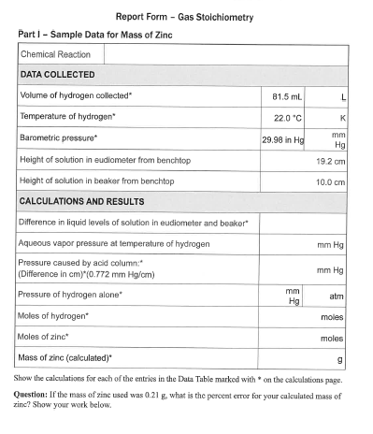
Moles : Ideal Gas Law
(Part I: Zinc Calculation Example)
Zn(s) + 2HCl(aq) → ZnCl₂(aq) + H₂ (g)
n H₂(g) = PV / RT
V = experimental volume (mL→ L)
R = 0.082057338 L atm K⁻¹ mol⁻¹

Slide 23
Moles : Ideal Gas Law
(Part I: Zinc Calculation Example)
Zn(s) + 2HCl(aq) → ZnCl₂(aq) + H₂ (g)
n H₂(g) = PV / RT
V = experimental volume (mL→ L)
T = experimental temperature (ºC → K)
R = 0.082057338 L atm K⁻¹ mol⁻¹

Slide 24
Moles : Ideal Gas Law
(Part I: Zinc Calculation Example)
Zn(s) + 2HCl(aq) → ZnCl₂(aq) + H₂ (g)
n H₂(g) = PV / RT
V = experimental volume (mL→ L)
T = experimental temperature (ºC → K)
P H₂(g) = pressure of H₂(g) in atm (mm Hg → atm)
P H₂(g) = P Total (barometric) - P H₂O (g) [TABLE] - P HCl (g)
R = 0.082057338 L atm K⁻¹ mol⁻¹

Slide 25
Moles : Ideal Gas Law
Part I: Hydrogen Calculation, (Refer to Form’s Data)
Zn(s) + 2HCl(aq) → ZnCl₂(aq) + H₂ (g)
n H₂(g) = PV / RT
n = moles H₂(g)
P H₂(g) = pressure of H₂(g) in atm (mm Hg → atm)
P H₂(g) = 29.98 inches Hg (barometric) - 19.8 mm Hg H₂O (g) [TABLE] - P HCl (g)
P HCl (g)
R = 0.082057338 L atm K⁻¹ mol⁻¹
19.2 cm
10.0 cm

Slide 26
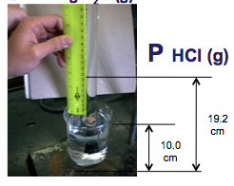
P H₂(g) = P Total (barometric) - P H₂O (g) [TABLE] - P HCl (g)
P HCl (g) =
19.2 cm Hg - 10.0 cm Hg = 92 mm Hg
HCl Height (mm) x 0.0772
= 7.1 mm Hg
__________
Density Hg is 12.95 times > density HCl(aq)
P HCl (g) =
19.2 cm Hg - 10.0 cm Hg = 92 mm Hg
HCl Height (mm) ÷ 12.95
= 7.1 mm Hg
___________
Density Hg is 12.95 times > density HCl(aq)
P HCl (g)
0.772 mm Hg/cm of acid solution

Slide 27
P H₂(g) = 761.5 mm Hg (barometric)
- 19.8 mm Hg H₂O (g) - 7.1 mm Hg HCl (g)
= 734.6 mm Hg
= 734.6 mm Hg / 760.0 mm Hg / 1.000 atm
= 0.9666 atm

Slide 28
Moles : Ideal Gas Law
(Part I: Hydrogen Calculation)
Zn(s) + 2HCl(aq) → ZnCl₂(aq) + H₂ (g)
n H₂(g) = PV / RT
n = moles H₂(g)
P H₂(g) = 0.9666 atm
V = 0.0815 L
T = 295.1 K
R = 0.08206 L atm K⁻¹ mol⁻¹
n H₂(g) =
0.00325 moles H₂(g)
= 0.00325 moles Zn(s)

Slide 29
% Error
Theoretical Mass Zinc vs. Experimental
(Part I: Calculation)
Zn(s) + 2HCl(aq) → ZnCl₂(aq) + H₂ (g)
mass (g) Zn(s) = mol Zn(s) x Molar Mass Zn(s)
= 0.00325 moles Zn(s) x 65.37 g/mol Zn(s)
experimental grams Zn(s) - theoretical grams Zn(s)
_________________________________________________________________________________________________________--________________
theoretical grams Zn(s)
% Error =
x 100
0.213 g - 0.21 g
___________________________________________________
0.21 g
=
x 100
= 1.4 %

Slide 30
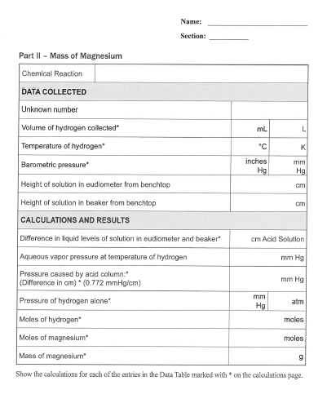
(Part II) Magnesium
Mg(s) + 2H⁺(aq) → Mg²⁺(aq) + H₂ (g)
Mole Calculations:
Stoichiometry Calculation
Ideal Gas Law Calculations
Comparison (% Error)
Mg(s) + 2HCl(aq) → MgCl₂(aq) + H₂ (g)
Bring Report Forms to Dr. R
Having Part I: Zinc (with calculations) completed
to get unknown Mg(s) sample(s).

Slide 31
(Part II) Magnesium
Mg(s) + 2H⁺(aq) → Mg²⁺(aq) + H₂ (g)
Mole Calculations:
Stoichiometry Calculation
Ideal Gas Law Calculations
Comparison (% Error)
Mg(s) + 2HCl(aq) → MgCl₂(aq) + H₂ (g)
Get equipment from stockroom and complete data acquisition for Part II.
Have individual Report Forms checked before leaving lab today.

Slide 32
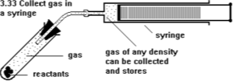
Molar Mass of any Gas
(Hydrogen for example)
PV = n RT
n = g of gas/ MM _{gas} [MM _{gas} = g/mol]
PV = (g of gas/ MM _{gas})RT
MM _{gas} = g of gas/V (RT/P)
Density of gas
MM _{gas} = g of gas/V (RT/P)
MM _{gas} = density of gas (RT/P)

